Slide 1
Heart Stroke Prediction
MACHINE LEARNING (19CSE305)
project
Contributors:
NAME : | ROLL NO:
Alety Deepthi Reddy | CB.EN.U4CSE20603
G Harshavardhan Tadikonda | CB.EN.U4CSE20621
M V S Karthik | CB.EN.U4CSE20639
Sathi Lakshmi Priyatha Reddy | CB.EN.U4CSE20654
Vaidehi Sridhar | CB.EN.U4CSE20668

Slide 2
PROJECT OVERVIEW
Problem Definition
Objective
Background
Data Selection
Dataset Description
Exploratory Data Analysis
Data Visualization
Feature Engineering
Models Implementation
Conclusion

Slide 3
PROBLEM DEFINITION
Human Heart is the principal part of the human body. Any irregularity to heart can cause distress in other parts of body.
Present day, heart stroke is one of the primary reasons for occurrence of most deaths. Heart stroke may occur due to unhealthy lifestyle, smoking, alcohol and high intake of fat which may cause hyper-tension.
According to the World Health Organization more than 10 million die due to Heart stroke every single year around the world.
Unfortunately, detecting such conditions in humans is a complex task. Handling such complex tasks can be done by using data sets.
As heart stroke prediction is a complex task, there is a need to automate the prediction process to avoid risks associated with it and alert the patient well in advance.

Slide 4
OBJECTIVE
Automation for the above mentioned task can be obtained by using various data mining techniques. Data mining techniques are the means of extracting valuable and hidden information from the large amount of data available.
Machine Learning (ML) which is subfield of data mining handles large scale well-formatted dataset efficiently. In the medical field, machine learning can be used for diagnosis, detection and prediction of various diseases.
The main goal of this project is to predict the chances whether a person may have heart stroke depending on the factors like age, gender, average glucose level, smoking status, body mass index, work type and residence type.
The proposed model predicts heart stroke prediction of several individuals using various machine learning algorithms like Random Forest, K-Nearest Neighbors, Decision Tree Classifier, Support Vector Machine, Logistic Regression and Naïve Bayes based on these input factors which has been taken from the dataset on which the model has been trained.
Therefore, the aim of this project is to compare the above-mentioned algorithms & find out which is more accurate in accomplishing the task. At the end our project presents performance analysis of various ML techniques implemented.

Slide 5
BACKGROUND
Recently in the March 2022, Chetan Sharma, Shamneesh Sharma, Mukesh Kumar, Ankur Sodhi have made the project named
EARLY STROKE PREDICTION USING MACHINE LEARNING
They have made a conference paper, and presented it internationally.
Conference: 2022 International Conference on Decision Aid Sciences and Applications (DASA)
At: Mae Fah Laung University, Thailand
Reference Link: https://www.researchgate.net/publication/359518651_Early_Stroke_Prediction_Using_Machine_Learning

Slide 6
DATA SELECTION
The Dataset is taken from
https://www.kaggle.com/code/rohsikdak/stroke-disease/data
This is a detailed dataset which includes all kinds of parameters and factors that can play a role in determining whether a person will have stroke.
Here what we consider to be the most important among attributes which determine the same, include the gender, average glucose, BMI, age, hypertension, heart disease history and smoking status. Although, work and lifestyle also do have a kind of role.
Each row in the data provides relevant information about the patient.

Slide 7
DATASET DESCRIPTION
A | DATA TYPE
ID | INTEGER
GENDER | CATEGORICAL : Male, Female, Other
AGE | FLOAT
HYPERTENSION | CATEGORICAL : 1, 0
HEART_DISEASE | CATEGORICAL : 1, 0
EVER_MARRIED | CATEGORICAL : 1, 0
WORK_TYPE | CATEGORICAL : Private, Self, Govt, Never_worked, children
RESIDENCE_TYPE | CATEGORICAL : Urban, Rural
AVG_GLUCOSE_LEVEL | FLOAT
BMI | FLOAT
SMOKING_STATUS | CATEGORICAL : Never Smoked, Formerly Smoked, Smoking_unknown
STROKE | CATEGORICAL : 1, 0

Slide 8
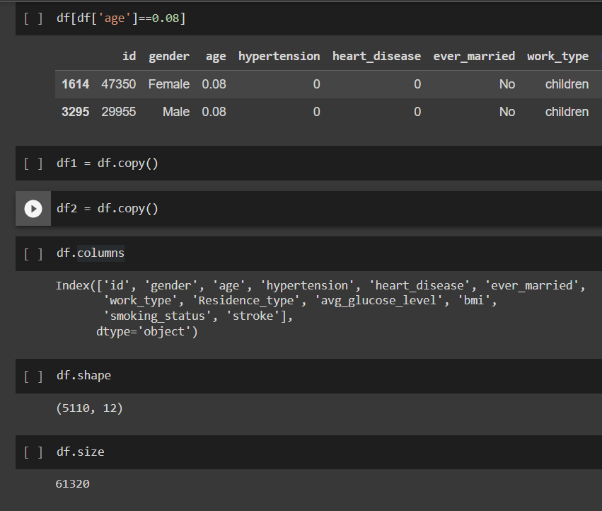
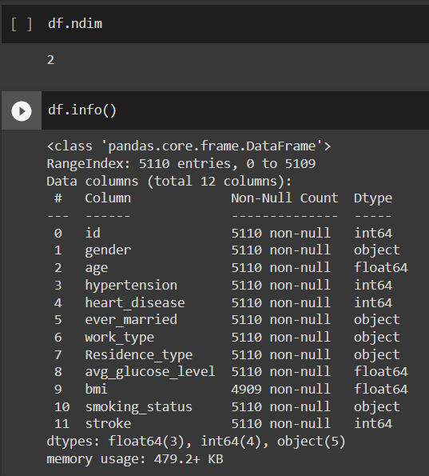
EXPLORATORY DATA ANALYSIS
Exploratory Data Analysis refers to the critical process of performing initial investigations on data so as to discover patterns, to spot anomalies, to test hypothesis and to check assumptions with the help of summary statistics and graphical representations.

Slide 9
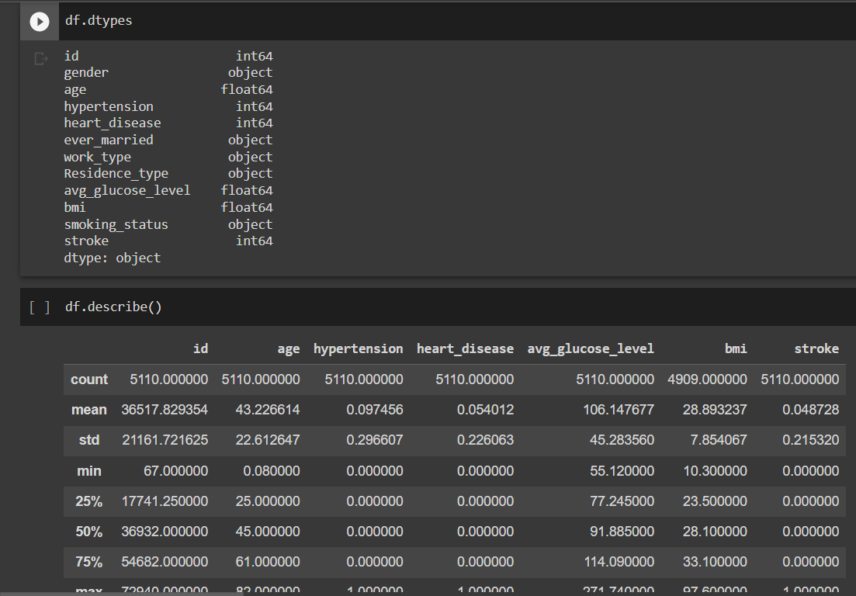
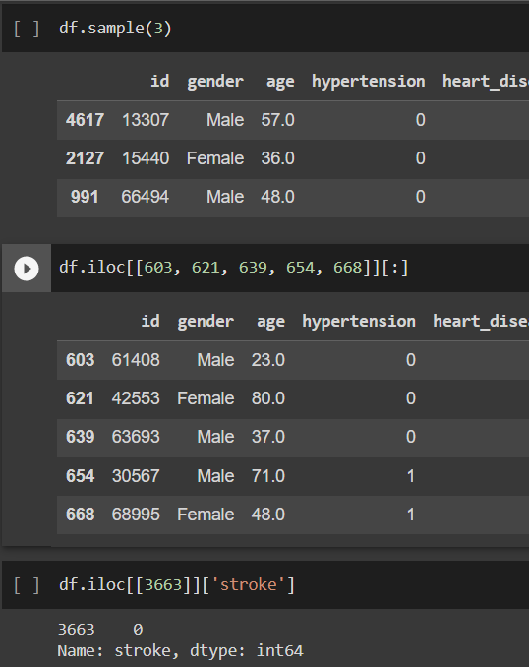
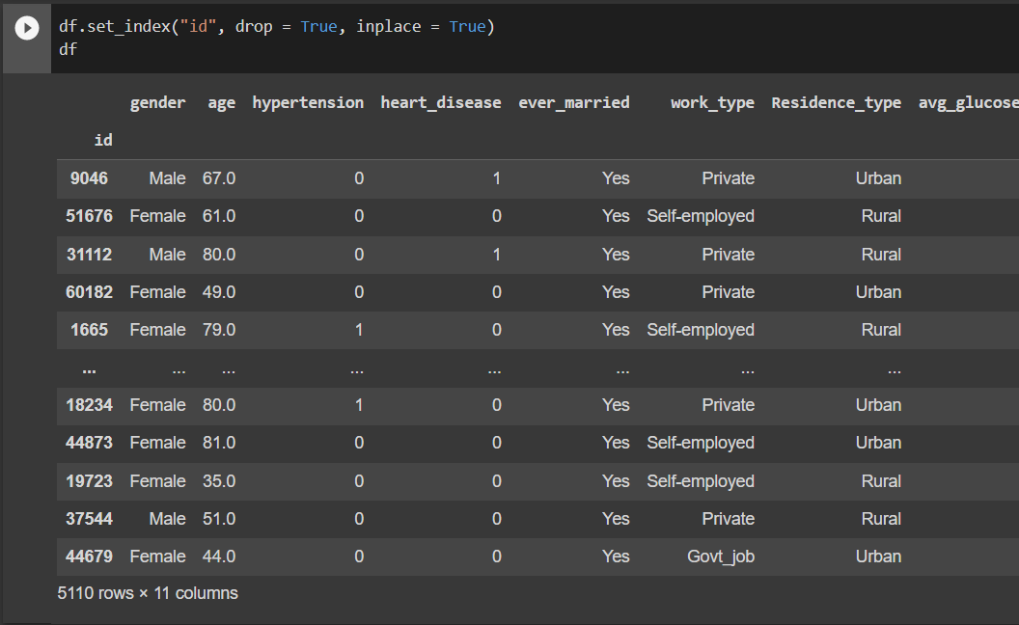

Slide 10
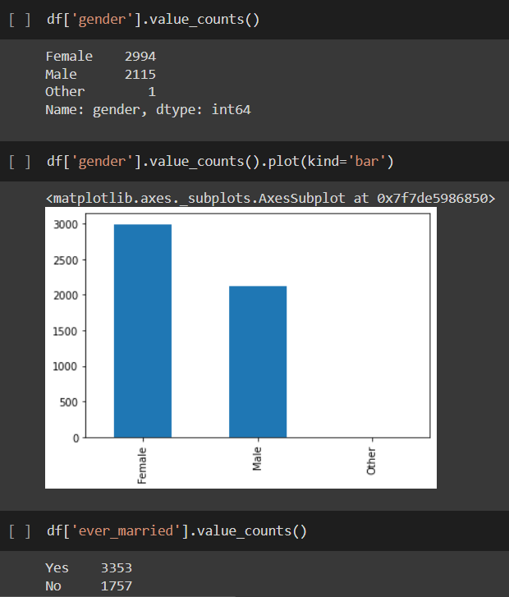
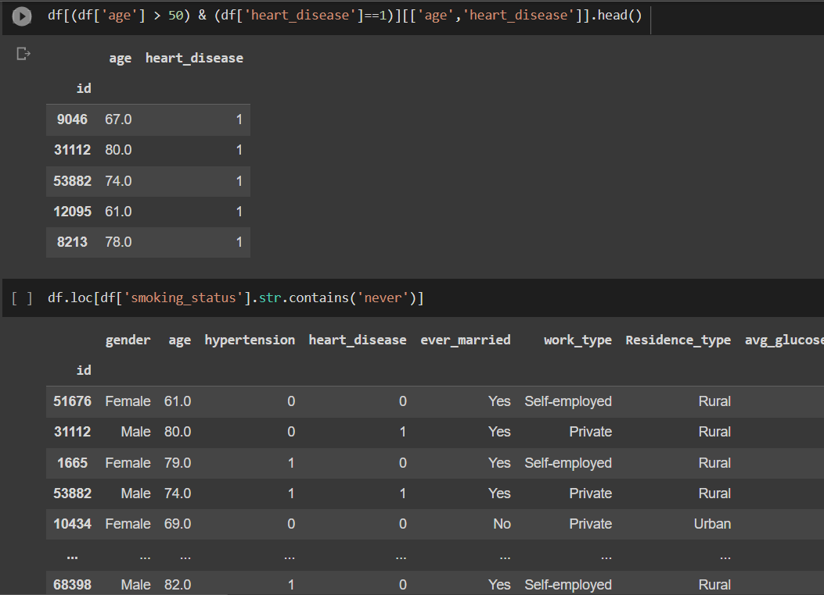
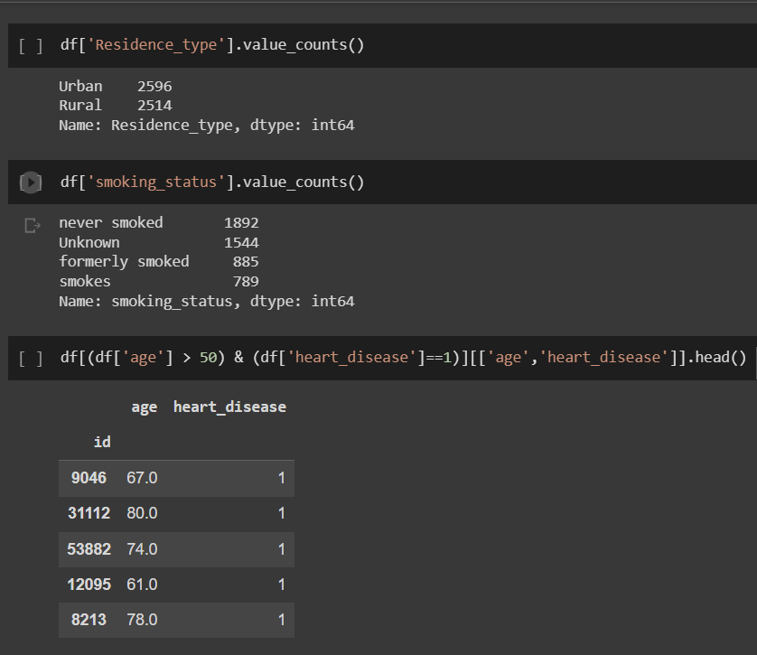
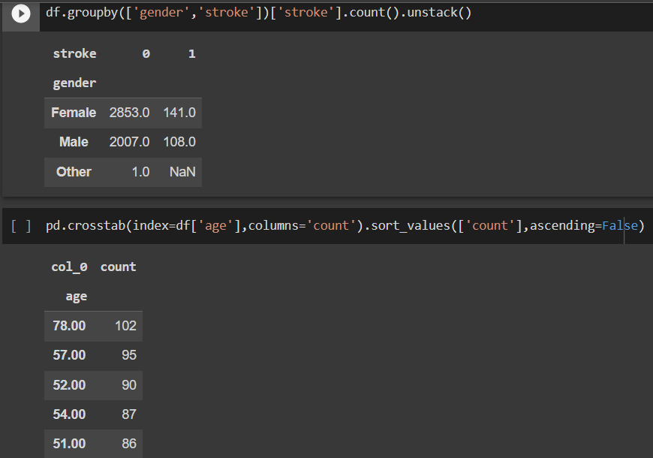

Slide 11
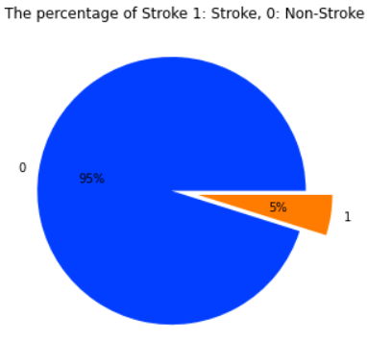
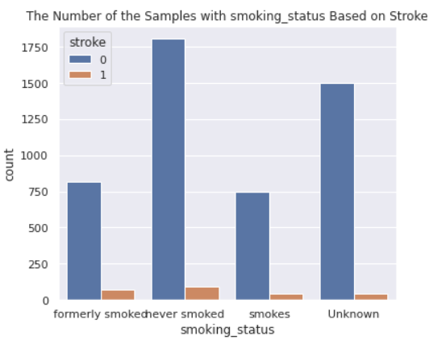
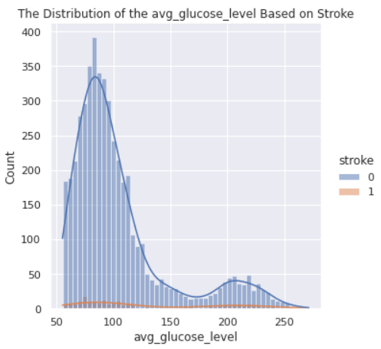
DATA VISUALIZATION
Data visualization is the representation of data through use of common graphics, such as charts, plots, infographics, and even animations. These visual displays of information communicate complex data relationships and data-driven insights in a way that is easy to understand.

Slide 12
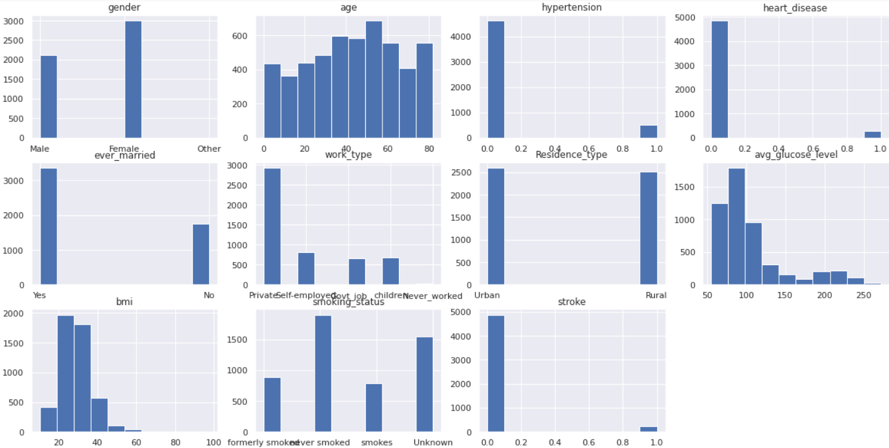
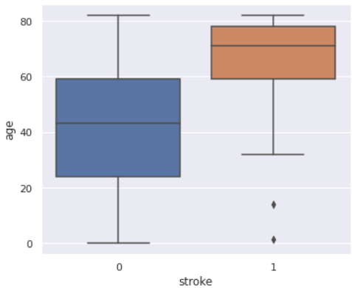
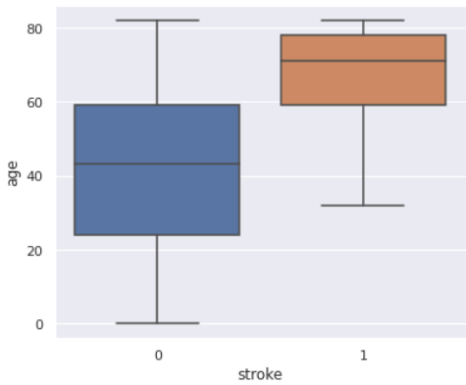
Box Plot without Outliers
Box Plot with Outliers

Slide 13
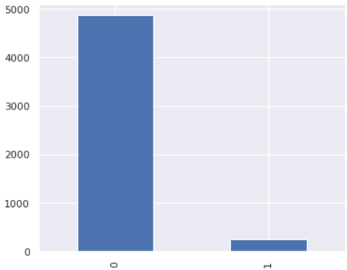
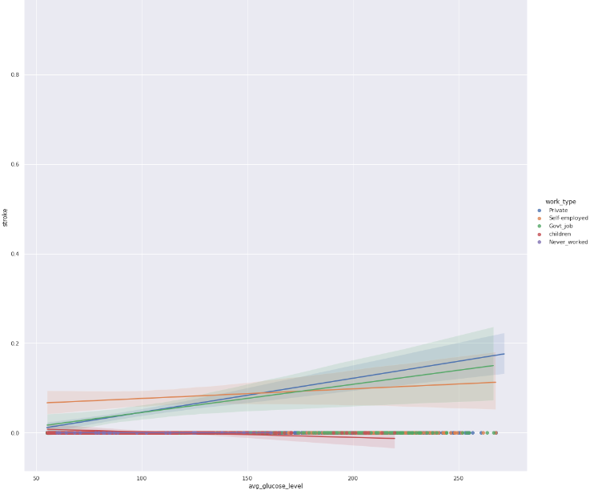
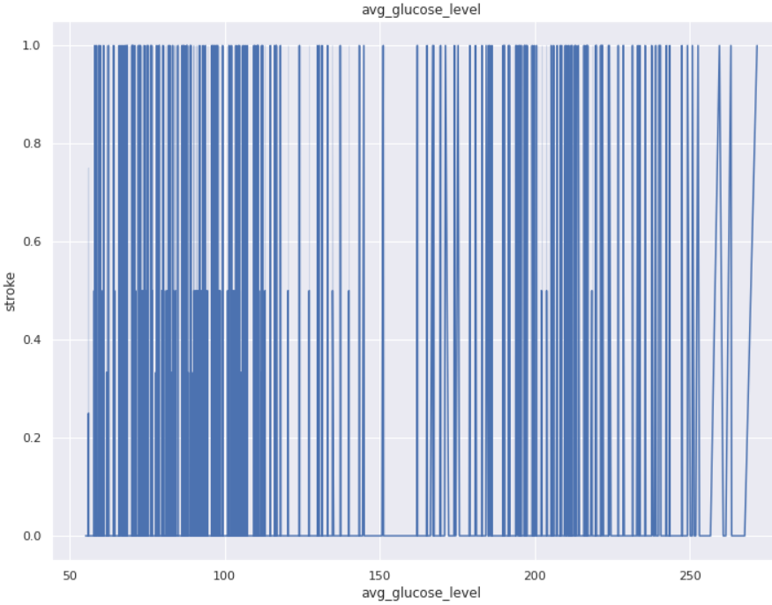
Bar Plot Based - Stroke
LM Plot Based – Avg Glucose Level
Seaborn Plot - Avg Glucose Level

Slide 14
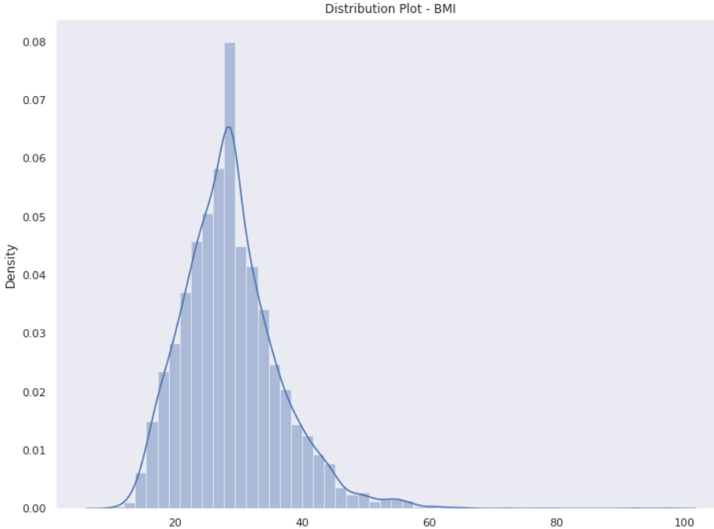
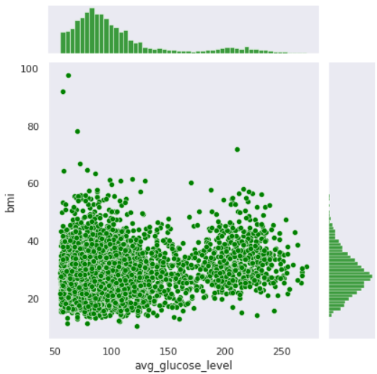
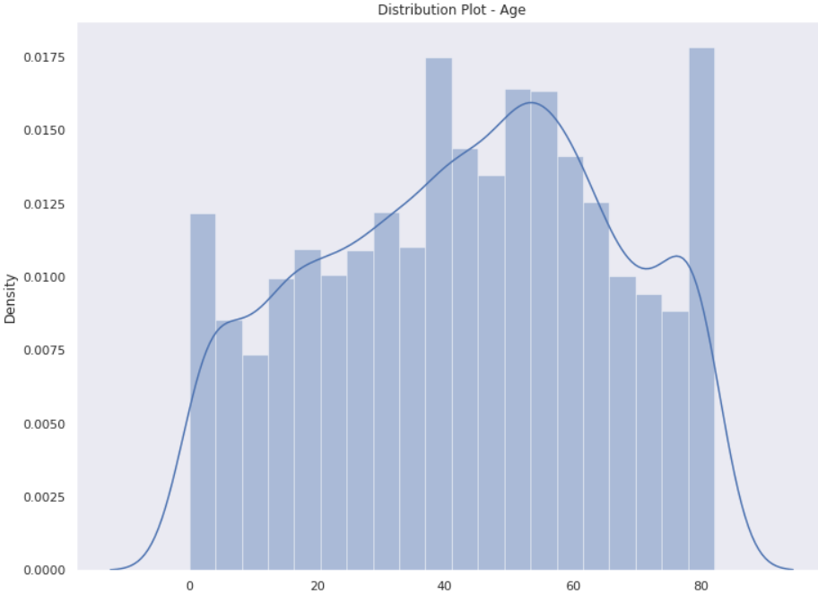
Joint Plot – Avg Glucose Level, BMI

Slide 15
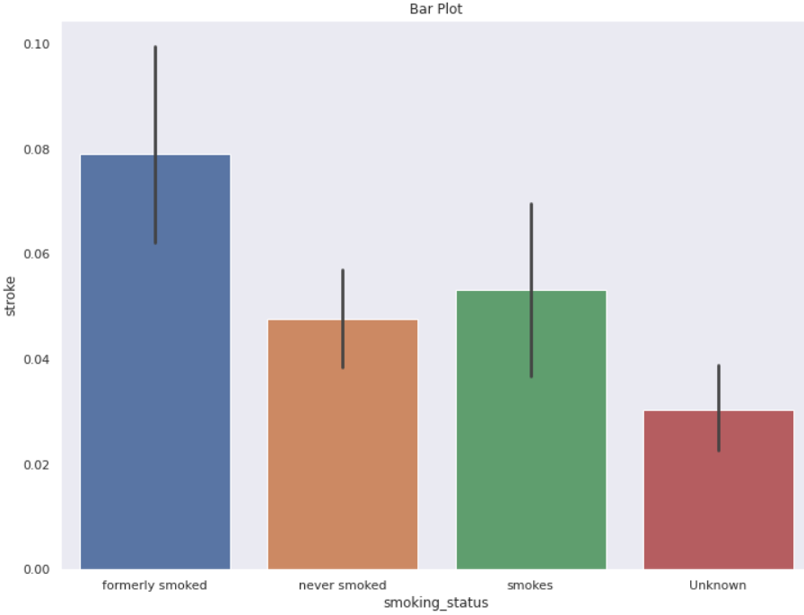
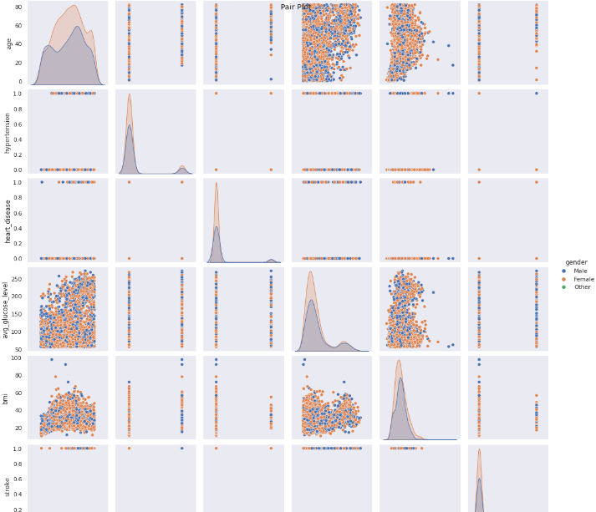
Seaborn Pair Plot

Slide 16
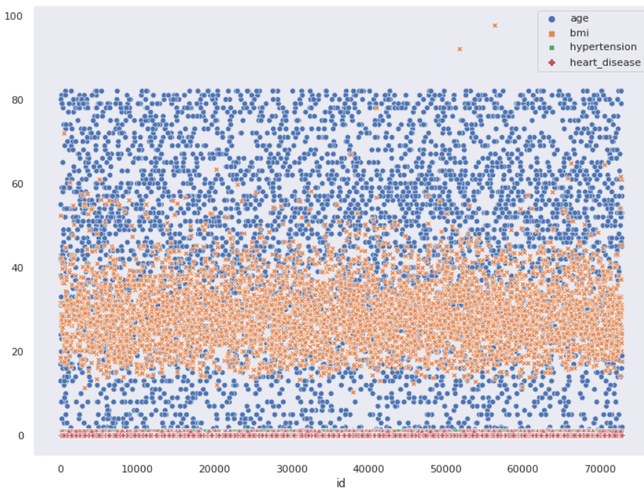
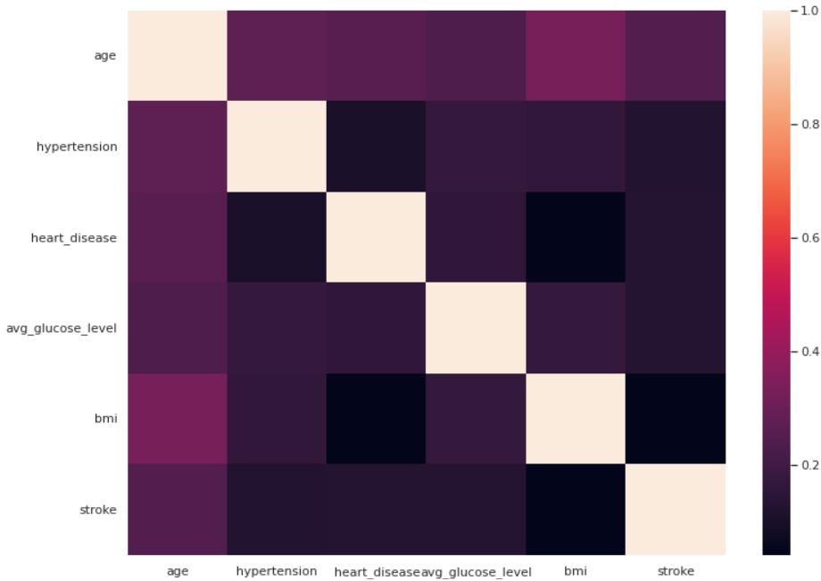
Seaborn Scatter Plot
Seaborn Heat Map

Slide 17
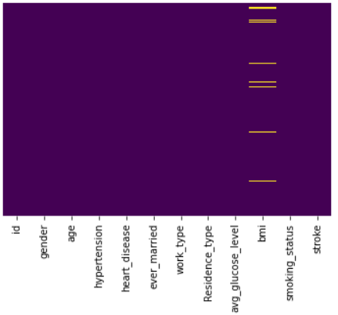
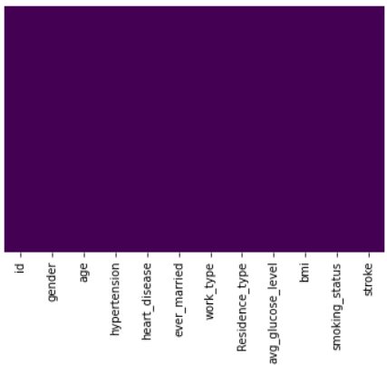
FEATURE ENGINEERING
Handling Missing & Null Values :
Detected the null values and replaced it with mean of that feature.
Seaborn Heatmap - Data After Removing Null Values
Seaborn Heatmap - Data with Null Values

Slide 18
FEATURE ENGINEERING
Removal of Outliers :
Detected the outliers and removed them.
Box Plot without Outliers
Box Plot with Outliers

Slide 19
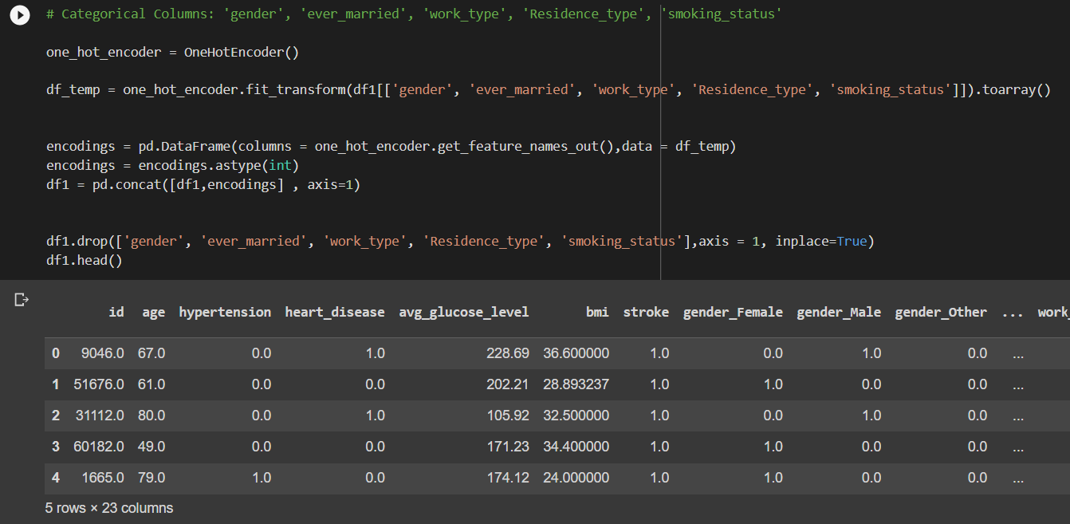
FEATURE ENGINEERING
One Hot Encoding :
Used to convert the categorical data variables to be provided to machine learning algorithms which can improve predictions as well as classification accuracy of a model. Here the categorical data is converted to binary vector form of numerical kind of data, thus creating a number of additional features based on the number of unique values in the categorical feature.

Slide 20
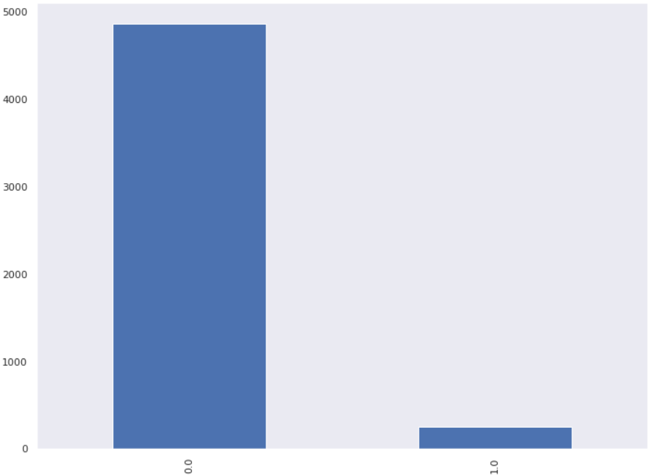
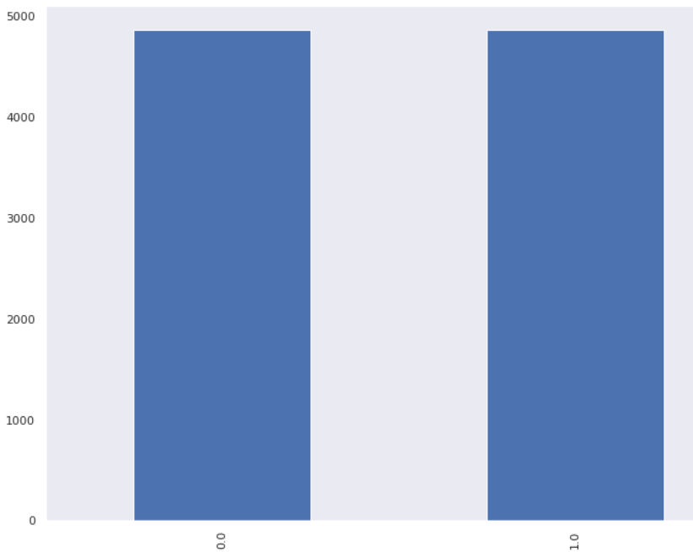
FEATURE ENGINEERING
Random Over Sampling
Imbalanced datasets are those where there is a severe skew in the class distribution, such as 1:100 or 1:1000 examples in the minority class to the majority class.
This bias in the training dataset can influence many machine learning algorithms, leading some to ignore the minority class entirely. This is a problem as it is typically the minority class on which predictions are most important.
One approach to addressing the problem of class imbalance is to randomly resample the training dataset. The two main approaches to randomly resampling an imbalanced dataset are to delete examples from the majority class, called under sampling, and to duplicate examples from the minority class, called oversampling.

Slide 21
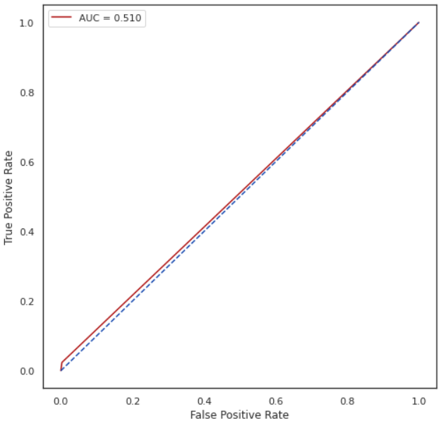
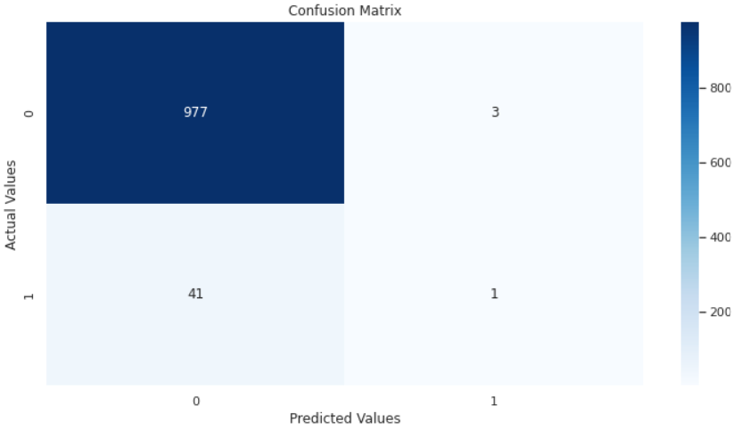
MODELS IMPLEMENTATION
Logistic Regression
Since the output variable is stroke whose values are either yes or no so it is a binary classification problem. So we can use logistic regression.
Logistic regression is a type of regression we can use when the response variable is binary.
To evaluate the quality of a logistic regression model is to create a confusion matrix, which is a 2×2 table that shows the predicted values from the model vs. the actual values from the test dataset.
Confusion Matrix
AUC Graph

Slide 22
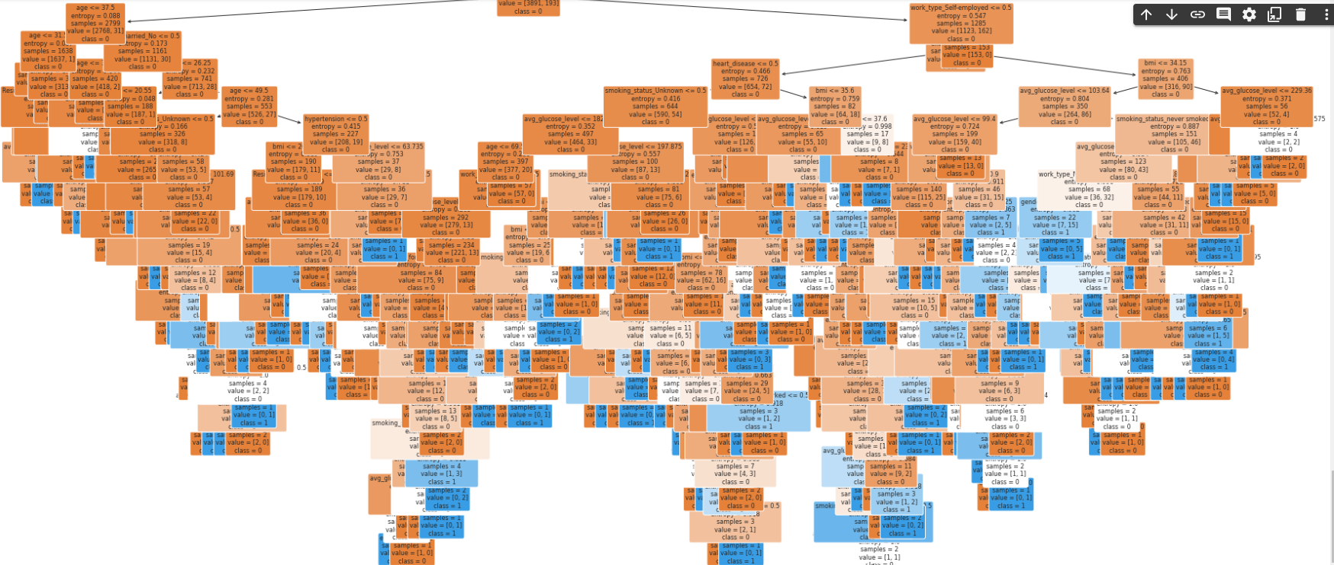
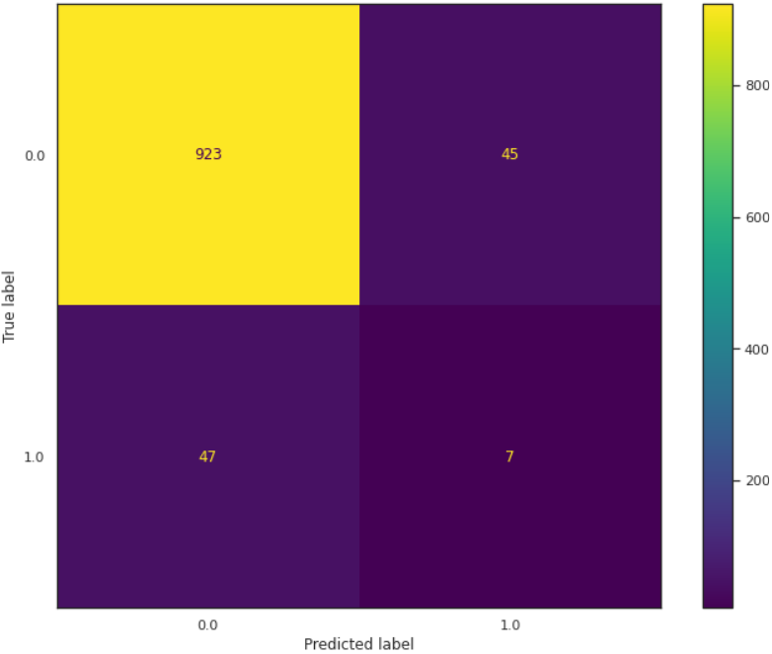
MODELS IMPLEMENTATION
Decision Tree
A decision tree is one of the supervised machine learning algorithms. This algorithm can be used for regression and classification problems — yet, is mostly used for classification problems. A decision tree follows a set of if-else conditions to visualize the data and classify it according to the conditions.
Tree Graph
Confusion Matrix

Slide 23
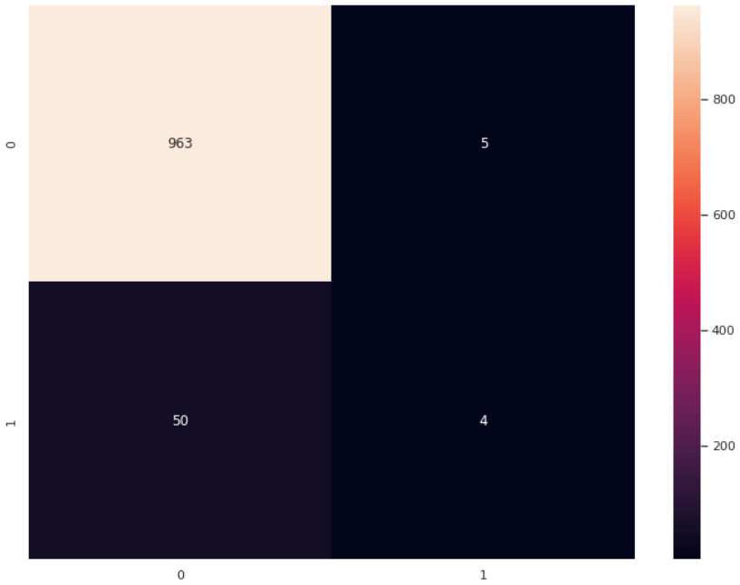
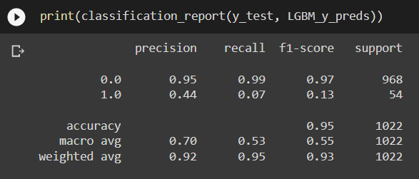
MODELS IMPLEMENTATION
LGBM (Light Gradient Boosting Machine) Classifier
Light GBM is a gradient boosting framework based on decision trees to increases the efficiency of the model and reduces memory usage.
It uses two novel techniques: Gradient-based One Side Sampling and Exclusive Feature Bundling (EFB)
Confusion Matrix

Slide 24
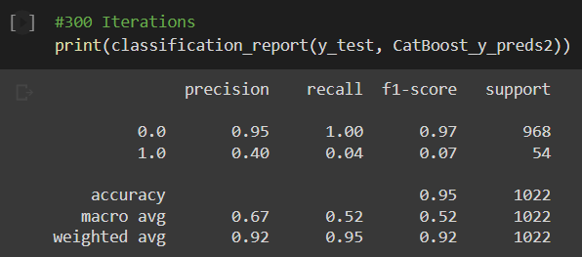


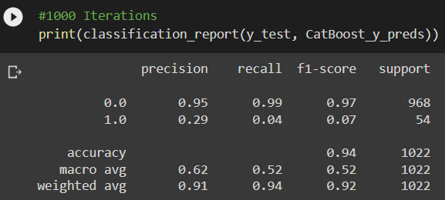
MODELS IMPLEMENTATION
Cat Boost Classifier
“Cat Boost” name comes from two words - “Category” and “Boosting”. Cat Boost is a high-performance open source library for gradient boosting on decision trees. Cat Boost is an algorithm for gradient boosting on decision trees.
It is a readymade classifier in scikit - learn’s conventions terms that would deal with categorical features automatically. Also, it provides best-in-class accuracy.
Confusion Matrix (300 Iterations)
Confusion Matrix (1000 Iterations)

Slide 25
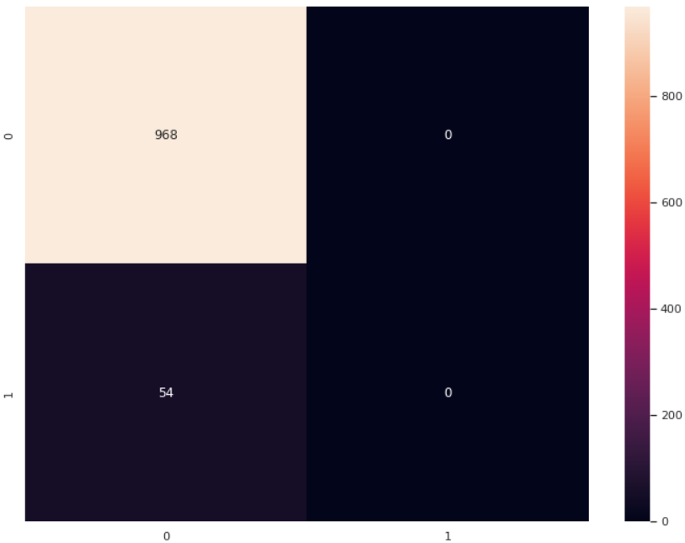
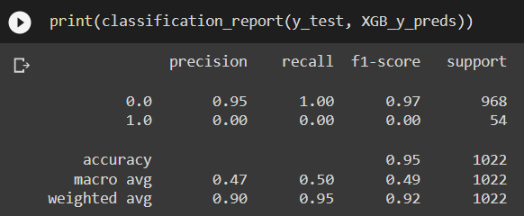
MODELS IMPLEMENTATION
XG Boosting
In this algorithm, decision trees are created in sequential form. Weights play an important role in XG Boost. Weights are assigned to all the independent variables which are then fed into the decision tree which predicts results. The weight of variables predicted wrong by the tree is increased and these variables are then fed to the second decision tree. These individual classifiers/predictors then ensemble to give a strong and more precise model. It can work on regression, classification, ranking, and user-defined prediction problems.
Confusion Matrix

Slide 26

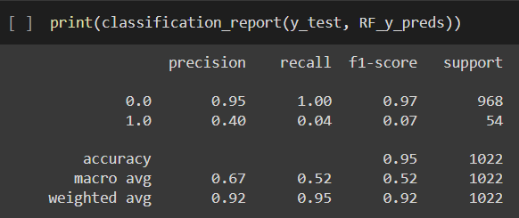
MODELS IMPLEMENTATION
Random Forest
Random Forest is a sophisticated and adaptable supervised machine learning technique that creates and combines a large number of decision trees to create a "forest". This can be used to solve classification and regression problems.
The random forest is a classification algorithm consisting of many decisions trees. It uses bagging and feature randomness when building each individual tree to try to create an uncorrelated forest of trees whose prediction by committee is more accurate than that of any individual tree.
max_features = 2
Confusion Matrix

Slide 27
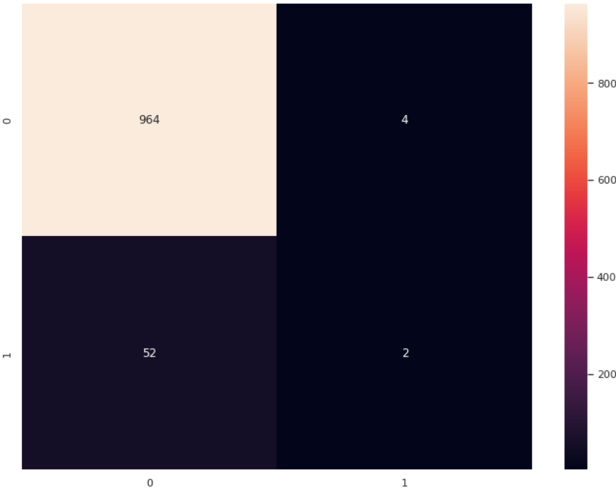
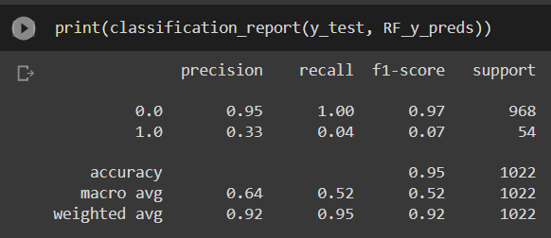

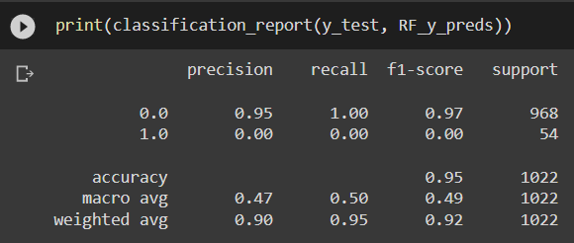
MODELS IMPLEMENTATION
max_features = 5
Confusion Matrix
max_features = 18
Confusion Matrix

Slide 28
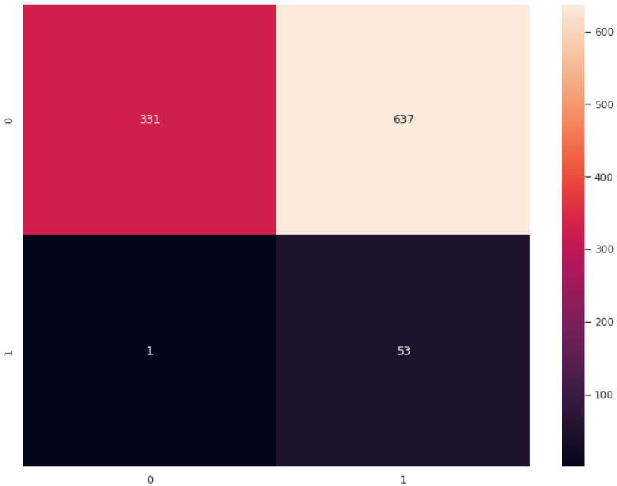
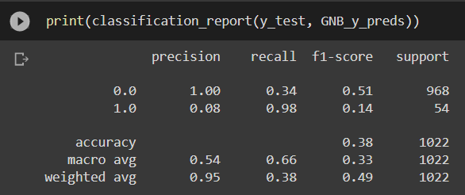
MODELS IMPLEMENTATION
Gaussian Naïve Bayes
Naïve Bayes algorithm is a supervised learning algorithm, which is based on Bayes theorem and used for solving classification problems. It is mainly used in text classification that includes a high-dimensional training dataset.
Naïve Bayes Classifier is one of the simple and most effective Classification algorithms which helps in building the fast machine learning models that can make quick predictions. It is a probabilistic classifier, which means it predicts on the basis of the probability of an object.
Confusion Matrix

Slide 29

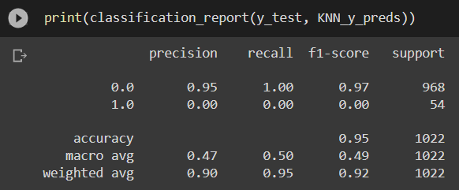
MODELS IMPLEMENTATION
KNN
K-Nearest Neighbour is one of the simplest Machine Learning algorithms based on Supervised Learning technique.
K-NN algorithm assumes the similarity between the new case/data and available cases and put the new case into the category that is most similar to the available categories.
K-NN algorithm stores all the available data and classifies a new data point based on the similarity. This means when new data appears then it can be easily classified into a well suite category by using K- NN algorithm.
It is also called a lazy learner algorithm because it does not learn from the training set immediately instead it stores the dataset and at the time of classification, it performs an action on the dataset.
K = 10
Confusion Matrix

Slide 30

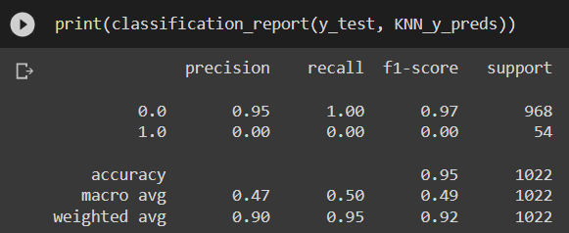

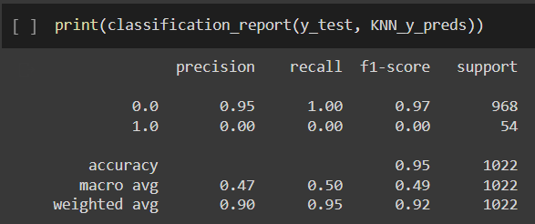
MODELS IMPLEMENTATION
K = 50
Confusion Matrix
K = 200
Confusion Matrix

Slide 31
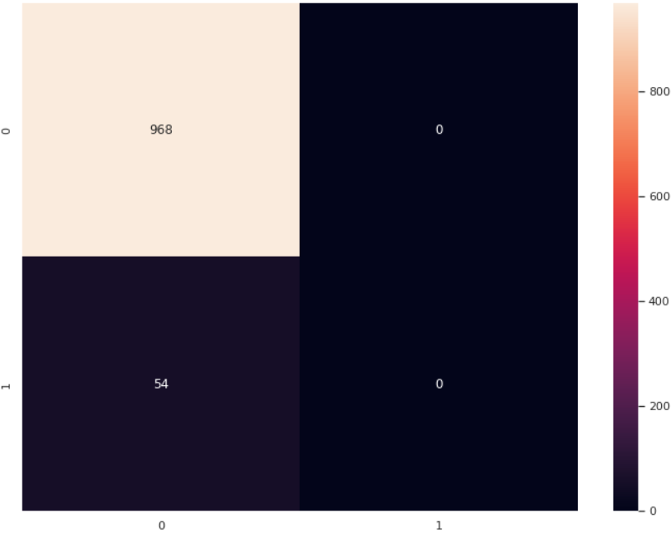



MODELS IMPLEMENTATION
K = 1000
Confusion Matrix
K = 4000
Confusion Matrix

Slide 32


MODELS IMPLEMENTATION
SVM (Support Vector Machine)
Support Vector Machine or SVM is one of the most popular Supervised Learning algorithms, which is used for Classification as well as Regression problems. However, primarily, it is used for Classification problems in Machine Learning.
The goal of the SVM algorithm is to create the best line or decision boundary that can segregate n-dimensional space into classes so that we can easily put the new data point in the correct category in the future. This best decision boundary is called a hyperplane.
Confusion Matrix

Slide 33



MODELS IMPLEMENTATION
K – Means Clustering
K-Means Clustering is an Unsupervised Learning algorithm, which groups the unlabeled dataset into different clusters. Here K defines the number of pre-defined clusters that need to be created in the process, as if K=2, there will be two clusters, and for K=3, there will be three clusters, and so on.
It allows us to cluster the data into different groups and a convenient way to discover the categories of groups in the unlabeled dataset on its own without the need for any training.
It is an iterative algorithm that divides the unlabeled dataset into k different clusters in such a way that each dataset belongs only one group that has similar properties.
It is a centroid-based algorithm, where each cluster is associated with a centroid. The main aim of this algorithm is to minimize the sum of distances between the data point and their corresponding clusters.
Confusion Matrix

Slide 34



MODELS IMPLEMENTATION
Agglomerative Clustering
Agglomerative is a bottom-up approach, in which the algorithm starts with taking all data points as single clusters and merging them until one cluster is left.
As we already have other clustering algorithms such as K-Means Clustering, then why we need hierarchical clustering? So, as we have seen in the K-means clustering that there are some challenges with this algorithm, which are a predetermined number of clusters, and it always tries to create the clusters of the same size. To solve these two challenges, we can opt for the hierarchical clustering algorithm because, in this algorithm, we don't need to have knowledge about the predefined number of clusters.

Slide 35

FINAL COMPARISON CHART

Slide 36
CONCLUSION
In this project, we developed a stroke prediction system that detects stroke using real-time bio-signals with machine learning techniques.
The performance of the proposed system was verified by using different parametric measure as accuracy, sensitivity, specificity, precision, recall, and F1 Score.
There isn’t much difference between our cross validation accuracy to that of our baseline model accuracy from this we can conclude there is no overfitting or underfitting in our model.
Among all the models tested, an ensemble learning model built using Logistic Regression, K Nearest Neighbours, Support Vector Machine, Random Forest models as base estimators performs the best for the Heart Stroke Prediction task.
The best accuracy reached on the test data is 95.30%

